Slide 1
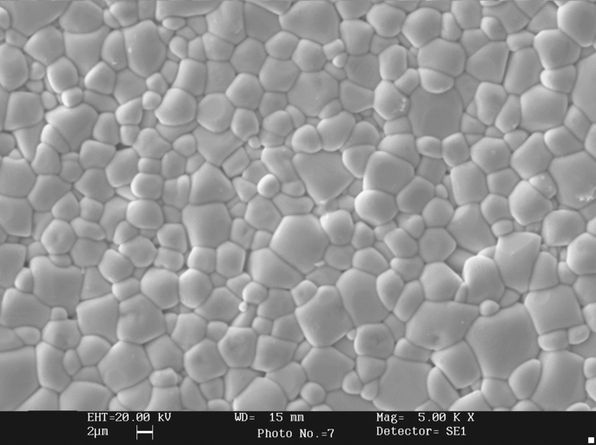
Ferroperm™ Piezoelectric
Pz21 Very soft relaxor type PNN-PZT
Key benefits
Lowest batch to batch variation in the industry
Stable material with consistent performance
Customised or standard designs
Key features
High sensitivity
Low porosity
Small grain size
Microstructure of Pz21 at a magnification of 5000 times
A very soft relaxor based PNN-PZT solid solution
Pz21 is a very soft piezoceramic material with very high coupling factors and charge coefficients. The material is optimised for applications where high sensitivity, low porosity and small grain size are required.
Repeatable performance
The main focus through our entire production process is to provide materials and components with the highest possible reproducibility of properties and parameters and to obtain the lowest aging rates in the industry.
Our materials have a variation of ±5% for all parameters. This reduces the requirements for impedance matching, frequency tuning and dimensioning of the housing meaning fewer rejects and lower costs.
Customised solutions
We have more than 60 years of experience in the production of advanced piezoelectric ceramics. Our team has extensive expertise in customising designs to match the customer’s needs.
Please contact us to discuss your requirements in further detail.
Applications
1D and 2D medical arrays
for imaging systems
Shear Inkjet print heads
Underwater acoustic sensors
High precision flow meters
Contact
Meggitt A/S
Porthusvej 4, DK-3490
Kvistgaard
Denmark
Tel: +45 49 12 71 00
e-mail:pz@ferroperm.net www.meggittferroperm.com

Slide 2
Aerospace Defence Energy Industrial Medical
Ferroperm™ Piezoelectric
Pz21 Very soft relaxor type PNN-PZT
Material properties
Electrical
Symbol
Pz21
Relative dielectric permittivity at 1 kHz
T
3800
Dielectric dissipation factor at 1 kHz
^{K}33
17 x 10⁻³
tan δ
Curie temperature
T_{C} >
~220 °C
Recommended working range
<
~130 °C
Electromechanical
Coupling factors
k_{p}
0.60
k_{t}
0.47
^{k}33
0.69
Piezoelectric charge coefficient
^{d}33
650 pC/N
Mechanical
Mechanical Quality Factor
^{Q}m,P
65
Density
ρ
7.80 g/cm³
Note: Due to continuous process improvement, specifications are subject to change without notice.
Please be aware that extreme dimensions and geometries can lead to exaggeration in tolerances in all materials.
Permittivity (blue) and dielectric loss factor (red) for Ferroperm Pz21. The Curie point is above 220°C and the increase in permittivity in the recommended working range from 20° to 130°C is only 0.26% per °C.
Planar coupling factor (blue) and planar frequency constant (red) for Ferroperm Pz21 as a function of temperature. Very linear and stable behaviour is observed within the recommended working temperature range between 20°C and 130°C.
MSSDK_PZ21_201711

